Slide 1
RHadoop

Slide 2
RHadoop
RHadoop is a collection of packages that allow users to interact with Hadoop, a popular open-source distributed computing framework, using the R programming language.
R is commonly used for statistical analysis and data visualization, while Hadoop is designed for processing and storing large datasets across clusters of computers.
The RHadoop project includes several components:
RHDFS: This package provides R functions to interact with the Hadoop Distributed File System (HDFS), allowing users to read and write data to and from Hadoop.
RHive: RHive provides an interface to Apache Hive, a data warehouse infrastructure built on top of Hadoop. It allows users to run Hive queries directly from R, enabling data analysis and manipulation.
Rmr2 (formerly RHadoop Streaming): Rmr2 is an R package that allows users to write MapReduce programs in R. MapReduce is a programming model used for processing and generating large datasets in parallel across distributed clusters.
RHbase: RHbase is an interface to Apache HBase, a distributed, scalable, NoSQL database built on top of Hadoop. It allows users to interact with HBase tables from R.
By integrating R with Hadoop, RHadoop enables data scientists and analysts to leverage the power of Hadoop for processing large datasets, while still using the familiar R environment for data analysis and visualization.
This combination can be particularly useful for handling big data analytics tasks where traditional R-based methods may not be scalable.
Notes:
RHadoop is a collection of R packages that enable big data processing using R on Hadoop clusters. It integrates R’s statistical computing capabilities with Hadoop's distributed storage and processing power.

Slide 3
Designing data requirement
To perform the data analytics for a specific problem, it needs datasets from related domains.
Based on the domain and problem specification, the data source can be decided and based on the problem definition, the data attributes of these datasets can be defined.
For example, if we are going to perform social media analytics (problem specification), we use the data source as Facebook or Twitter. For identifying the user characteristics, we need user profile information, likes, and posts as data attributes.
Notes:
RHadoop is a collection of R packages that enable big data processing using R on Hadoop clusters. It integrates R’s statistical computing capabilities with Hadoop's distributed storage and processing power.

Slide 4
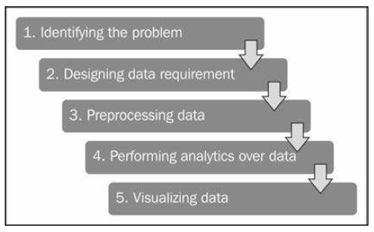
Data Analytics Project Life Cycle Stages

Slide 5
Identifying the problem
Today, business analytics trends change by performing data analytics over web datasets for growing business.
Since their data size is increasing gradually day by day, their analytical application needs to be scalable for collecting insights from their datasets.
With the help of web analytics, we can solve the business analytics problems.
Let’s assume that we have a large e-commerce website, and we want to know how to increase the business. We can identify the important pages of our website by categorizing them as per popularity into high, medium, and low. Based on these popular pages, their types, their traffic sources, and their content, we will be able to decide the roadmap to improve business by improving web trafic, as well as content.

Slide 6
Preprocessing data
In data analytics, we do not use the same data sources, data attributes, data tools, and algorithms all the time as all of them will not use data in the same format.
This leads to the performance of data operations, such as data cleansing, data aggregation, data augmentation, data sorting, and data formatting, to provide the data in a supported format to all the data tools as well as algorithms that will be used in the data analytics.
In simple terms, preprocessing is used to perform data operation to translate data into a fixed data format before providing data to algorithms or tools.
The data analytics process will then be initiated with this formatted data as the input.
In case of Big Data, the datasets need to be formatted and uploaded to Hadoop Distributed File System (HDFS) and used further by various nodes with Mappers and Reducers in Hadoop clusters.

Slide 7
Performing analytics over data
After data is available in the required format for data analytics algorithms, data analytics operations will be performed.
The data analytics operations are performed for discovering meaningful information from data to take better decisions towards business with data mining concepts.
It may either use descriptive or predictive analytics for business intelligence.
Analytics can be performed with various machine learning as well as custom algorithmic concepts, such as regression, classification, clustering, and model-based recommendation.
For Big Data, the same algorithms can be translated to MapReduce algorithms for running them on Hadoop clusters by translating their data analytics logic to the MapReduce job which is to be run over Hadoop clusters.
These models need to be further evaluated as well as improved by various evaluation stages of machine learning concepts.
Improved or optimized algorithms can provide better insights.

Slide 8
Visualizing data
Data visualization is used for displaying the output of data analytics.
Visualization is an interactive way to represent the data insights.
This can be done with various data visualization softwares as well as R packages.
R has a variety of packages for the visualization of datasets.
They are as follows:
ggplot2: This is an implementation of the Grammar of Graphics by Dr. Hadley Wickham (http://had.co.nz/). For more information refer http://cran.r-project.org/web/packages/ggplot2/.
rCharts: This is an R package to create, customize, and publish interactive JavaScript visualizations from R by using a familiar lattice-style plotting interface by Markus Gesmann and Diego de Castillo. For more information refer http://ramnathv.github.io/rCharts/.

Slide 9
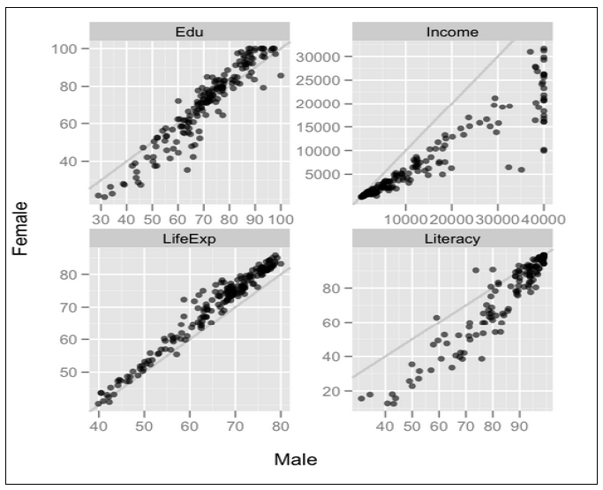
Popular examples of visualization with R
Plots for facet scales (ggplot): The following figure shows the comparison of males and females with different measures; namely, education, income, life expectancy, and literacy, using ggplot:

Slide 10
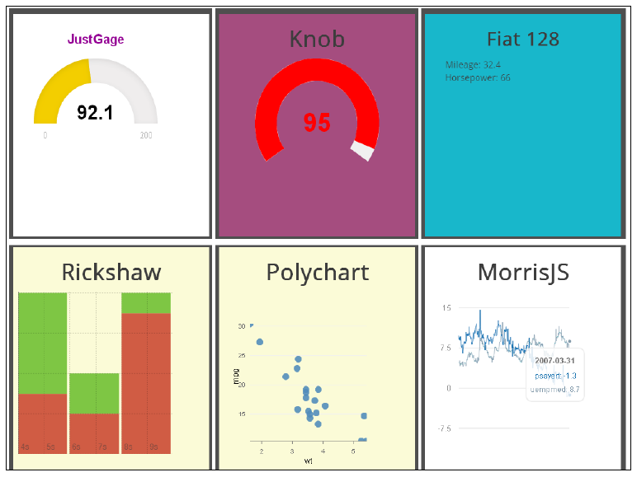
Dashboard charts: This is an rCharts type. Using this we can build interactive animated dashboards with R.

